Slide 1
ORGANIC CHEMISTRY SOME BASIC PRINCIPLES AND TECHNIQUES

Slide 2
INTRODUCTION
Tetravalence of carbon
Shape of carbon compounds
Carbon can form covalent bond and compound
Electronic configuration of carbon (Co¹²) = 1S²2S²2P²
Hybridisation -
alkane [C_{n} H_{2n+2}] - Sp³ Alkene [C_{n}H_{2n}] - Sp²
Eg. CH₄ Eg. C₂H₄
ie, H H H
| | |
H – C – H ie, C = C
| | |
H H H

Slide 3
Alkane [C_{n} H_{2n-2}] - sp
Eg. C₂H₂
H – C C – H
Note: If ‘s’ character is increased, bond length decreases.
Bond length = sp³ > sp² > sp
Bond Strength = sp > sp² > sp³
If ‘s’ character increased, then electronegativity also increased ie,
sp > sp² > sp³
Electronegativity can influence physical and chemical properties

Slide 4
Class Assignment
1. Each carbon atom in benzene is in the state of hybridization
1. sp³ 2. sp² 3. sp 4. s³p
2. The compound in which caron uses only its sp³ hybrid orbitals for bond formation is
1. HCOOH 2. (NH₂)₂CO
3. (CH₃)₃COH 4. (CH₃)₃CHO

Slide 5
3. A straight chain hydrocarbon has the molecular formula C₈H_{10.} The hybridization for the carbon atoms from one end of the chain to the other are respectively sp³ , sp², sp², sp³, sp², sp², sp and sp. The structural formula of the hydrocarbon would be

Slide 6

4. Number of $π$ electrons in cyclobutadieny1 anion (C₄H₄)⁻² is
1. 2 2. 4 3. 6 4. 8
5. Carbon atoms in the compound (CN)₄ C₂ are
1. sp hybridized 2. sp² hybridized
3. sp and sp² hybridized 4. SP, SP² and sp³ hybridized
6. Toluene has
1. 6$σ$ and 3 $π$ bond 2. 9$σ$ and 3 $π$ bond
3. 9$σ$ and 6 $π$ bond 4. 15$σ$ and 3 $π$ bond

Slide 7
Some Basic Characteristics of π Bond
One axial orientation & one sidewise overlapping.
σ
CH₂ = CH₂
π
All the atom must be in same plane.
The P-Orbitals are mutually parallel and both the P-Orbital are Perpendicular to the plane of the molecule.
In alkane, free C-C rotation is possible but in alkene and alkene, free rotation is restricted.

Slide 8
The electron charge cloud of the π-bond is located above and below the plane of bonding atoms. This result in the electrons being easily available to the attacking reagents. π bond provide the most reactive centers of molecules containing multiple bonds.
QN. Try to find no. of σ and π bond in the following
A. Benzene
B. Tolune
C. CH₃-CH₂-CH₃
D. CH = C – CH₂-CH=CH₂
E. CH₂=C=CH-CH₃

Slide 9
7. Allyl isocyanide has
1. 9 sigma bonds and 4 pi bonds
2. 8 sigma bonds and 5 pi bonds
3. 8 sigma bonds, 3 pi bonds and 4 non-bonding electrons
4. 9 sigma bonds, 3 pi bonds and 2 non-bonding electrons

Slide 10
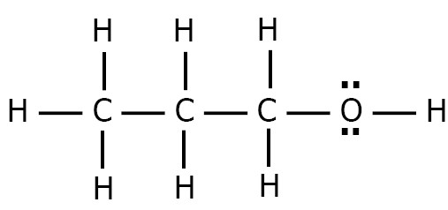
STRUCTURAL REPRESENTATION OF ORGANIC COMPOUNDS
Molecular Formulae:
There is no information about the connectivity but shown number and type of atoms.
E.g. C₃H₈O
2. Lewis Structure:
Shown all atoms, bonds, connectivity and lone pairs.
Eg.

Slide 11
3. Condensed Formula
    Does not shown bonds and lone pair but shown all the atoms and their connectivity.
  E.g. CH₃CH₂CH₂OH
  4. Partially condensed Formula
  It is a condensed structure with some bonds and lone pairs
  ..
  CH₃CH₂ - O – H
  ..

Slide 12


Three-Dimensional Representation of Organic Molecules
The three – dimensional (3-D) structure of organic molecules can be represented on paper by using certain conventions. For example, by using solid { } and dashed { } wedge formula, the 3-D image of a molecule from a two – dimensional picture can be perceived. In these formulas the solid-wedge is used to indicate a bond projecting out of the plane of paper, towards the observer. The dashed-wedge is used to depict the bond projecting out of the plane of the paper and away from the observer. Wedges are shown in such a way that the broad end of the wedge is towards the observer. The bonds lying in plane of the paper are depicted by using a normal line. (-). 3-D representation of methane molecule on paper.

Slide 13
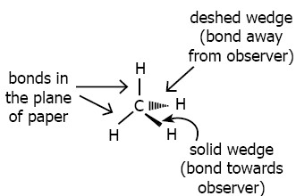
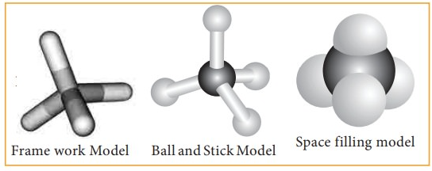

Slide 14
5. Bond line Structure
Only C-C bonds are represented
Longest C-C is represented in Zig-Zag pattern
Hetero atoms are always represented.
Double bonds are shown with two line and triple bonds with three lines.

Slide 15
Q. Find molecular formulae, condensed, partially condensed, bond line, Lewis structure of the following.
A. Ethanol B. n-pentane
C. Iso – butane D. 2-Bromo butane
E. 3-methyloctane F. Cyclo pentane
G. Chlorocyclohexane H. CH(OH)(CN)₂

Slide 16
Classification of Organic Compounds
ORGANIC COMPOUNDS
Acyclic/Open chain
Cyclic/Closed Chain or ring compounds
Alicyclic
Aromatic Compounds
Homocyclic
Heterocyclic
Benzenoid
Non benzenoid
Heterocyclic

Slide 17
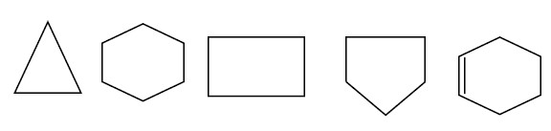
Acyclic
  When a compound contain only straight chain or branched hydrocarbon.
  Eg: Propane CH₃-CH₂-CH₃
  Iso butane CH₃-CH-CH₃
  |
  CH₃
  Pentanol CH₃-CH₂-CH₂-CH₂-CH₂-OH
  Acetaldehyde CH₃-CHO
  2. Ring Compounds a. Alicyclic
  It contain carbon atoms joined in the ring – Homocyclic

Slide 18
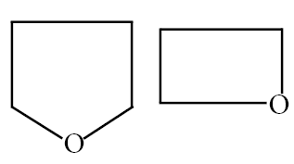
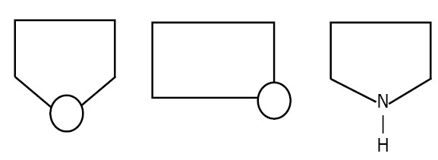
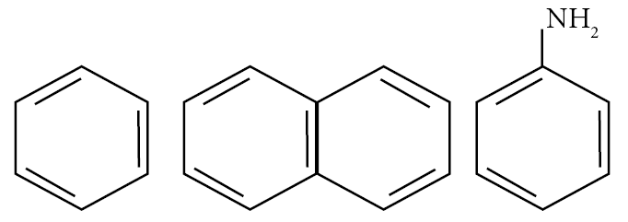
Some time, other than carbon also present in the ring Hetero cyclic
B. Aromatic Compounds
Benzenoid [Aromatic with benzene Ring]

Slide 19
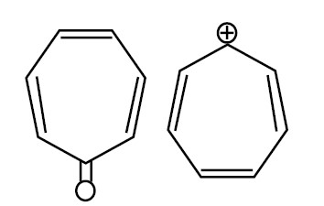
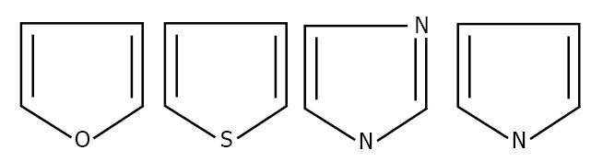
Non benzenoid [Without benzene ring]
(Homocyclic)
Heterocyclic

Slide 20
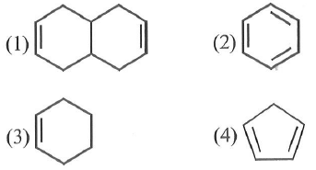
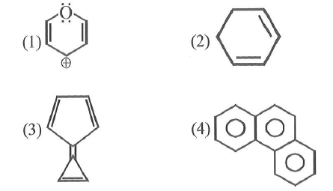
8. Which of the following will show aromatic behaviour
1. 2.
3. 4.
9. Which is not aromatic compound;
1. 2.
3. 4.

Slide 21
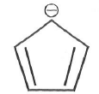
10. How many $π$ electron are there in the following species:
1. 2 2. 4 3. 6 4. 8

Slide 22
Functional Group
When one hydrogen atom can be replaced by the use of other atom or group of atoms in a hydrocarbon.
E.g. CH₃-OH (alcohol)
CH₃-CHO (Aldehyde)
CH₃-CO-CH₃ (Ketone)
CH₃-COOH (Carboxylic acid)
CH₃-SH (Thiol)
CH₃-CN (Cyanide)
CH₃NC (Isocyanide)

Slide 23
HOMOLOGOUS SERIES
A group or series of organic compound containing a characteristic functional group.
General molecular formula
Difference b/w two consecutive members are CH₂ group.
E.g. CH₃-OH
CH₃-CH₂-OH
CH₃-CHO
CH₃-CH₂-CHO
CH₃-CO-CH₃
CH₃-CO-CH₂-CH₃

Slide 24
11. General formula of alkyne is
1. C_{n} H_{2n+2} 2. C_{n}H_{2n} 3. C_{n}H_{2n-2} 4. C_{n}H_{n}
12. General formula of alkene and alkane are
1. C_{n}H_{2n} and C_{n}H_{2n+1} 2. C_{n}H_{2n} and C_{n}H_{2n+2}
3. C_{n}H_{2n-1} and C_{n}H_{2n}
4. C_{n}H_{2n-1} and C_{n}H_{2n+2}
13. General formula of paraffin is
1. C_{n}H_{2n} 2. C_{n}H_{2n-2} 3. C_{n}H_{2n+2} 4. C_{2n}H_{2n}

Slide 25
NOMENCLATURE OF ORGANIC COMPOUNDS
Introduced by IUPAC
IUPAC names usually consist of three parts
  ie, 1. Root word
  2. Suffix
  3. Prefix

Slide 26
1. Root Word
It represent number of carbon atom in the chain.
Number of `C’ atom | Word Root
C₁ | Meth
C₂ | Eth
C₃ | Prop
C₄ | But
C₅ | Pent
C₆ | Hex
C₇ | Hept
C₈ | Oct
C₉ | Non
C₁₀ | Dec

Slide 27
2. Suffix
Two types a. Primary Suffix
It indicates the nature of Carbon chain
[Saturated / Unsaturated]
C – C [Single bond] – ane
C = C [Double bond] – ene
C ≡ C [Triple bond] - yne

Slide 28
b. Secondary Suffix
It represents the functional group present in the Organic molecule. This is added to a primary suffix. The final `e’ in the primary suffix is dropped for secondary suffix beginning with a Vowel (a, e, i, o, u and y)
-OH → ol
-CHO → al
-COOH → oic acid
-CO → one
-CN → nitrile
-COOR → oate
-NC → carbylamine
-CONH₂ → amide
-COCl → oylchlorite

Slide 29
3. Prefixes
These indicate the substitution of other group in place of Hydrogen atom in the compound.
Cl → Chloro
Br → Bromo
I → Iodo
OR → alkoxy
NO₂ → nitro
NO → Nitroso

Slide 30
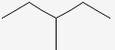
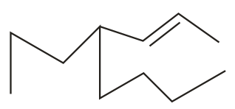
RULE
Prefix-2 + Prefix -1 + Word Root + Suffix 1 + Suffix 2
ALKANE
* CH₃ – CH₂ – CH₂ – CH₃
* CH₃ – CH – CH₃
|
CH₃
*
*

Slide 31

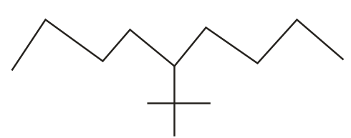
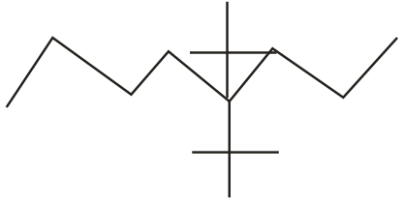
ALKENE
* CH₃ – CH₂ – CH – CH₂
CH₃
|
* CH₃ – CH – C - CH₃
* CH₂ = CH – CH = CH₂
*
*
*

Slide 32
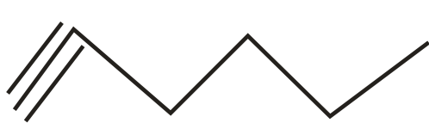
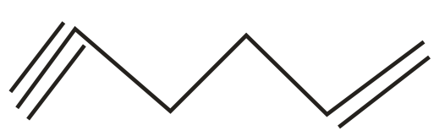
ALKYNE
* CH ≡ CH
* CH₃ – C ≡ C – CH₃
* CH₃ - CH₂ - C ≡ CH
*
*

Slide 33
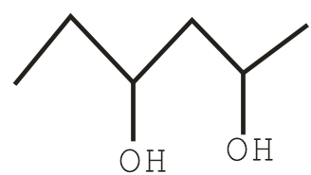
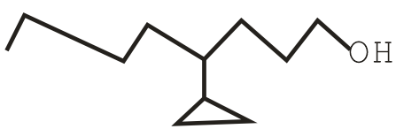
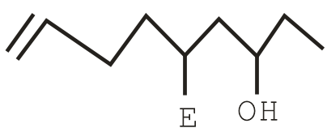
ALCOHOL
* CH₃ = OH
* CH₃ – CH₂ – OH
* CH₃ - CH – CH₂ – CH₃
|
OH
*
*
*

Slide 34

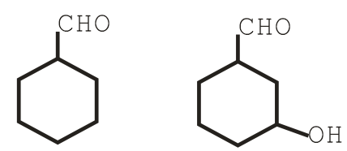
ALDEHYDE
* CH₃ - CHO
* CH₃ – CH₂ – CHO
*
*
* CHO – CH₂ – CH₂ – CHO
* CHO – CH₂ – CH – CHO
|
CHO

Slide 35
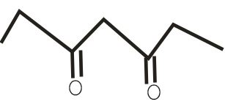
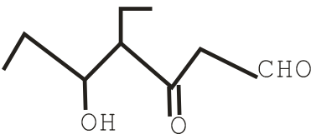
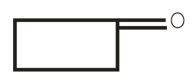
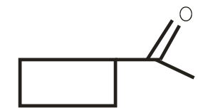
KETONE
* CH₃COCH₃
* CH₃–CO–CH₂-CH₂-CH₃
* CH₃-CO-CH₂-CO-CH₃
*
*
*
*

Slide 36
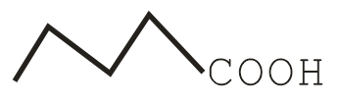
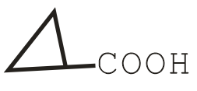
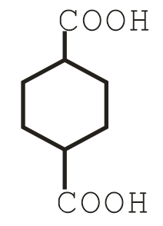
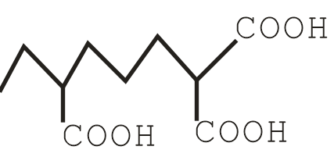
CARBOXYLIC ACID
* CH₃-COOH
* HCOOH
* CH₃-CH₂-CH₂-COOH
*
*
*
*

Slide 37
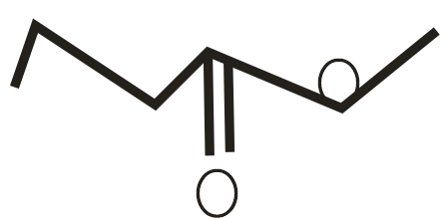
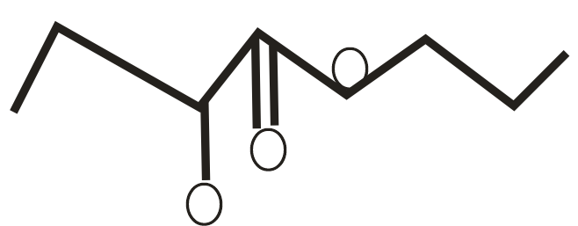
ESTER
* CH₃-CH₂-COOCH₃
* HCOOCH₃
*
*

Slide 38
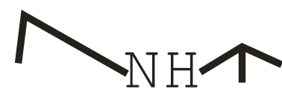
ARYL HALIDE
* CH₃(CH₂)₂COCl
* CH₃(CH₂)₄COCl
* CH₃(CH₂)₃COBr
AMINE
* CH₃NH₂
* CH₃CH₂CH₂NH₂
* CH₃-NH-CH₂-CH₃
* (CH₃)₃N
*

Slide 39
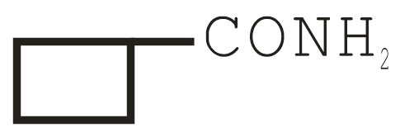
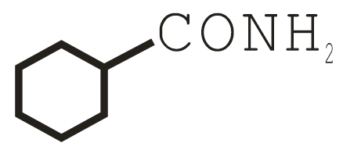
AMIDE
* CH₃CONH₂
* CH₃CH₂CONH₂
*
*

Slide 40
SULPHONIC ACID
* CH₃SO₃
O
||
* S – OH
||
O
O
||
* CH₃-CH₂-CH₂⁻CH₂-S-OH
||
O

Slide 41

ETHER
* CH₃-O-CH₃
* CH₃-CH₂-O-CH₃
*
* CH₃-CH₂-CH₂-O-CH₂-CH₃
* CH₃-O-CH-CH₃
|
CH₃

Slide 42


CYANIDE
* CH₃-CN
* CH₃-CH₂-CH₂CN
*
*

Slide 43
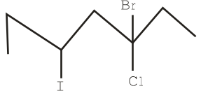
HALIDE
* CH₃-CH₂-Cl
* CH₃-CH-CH₂-CH₃
|
Br
*

Slide 44
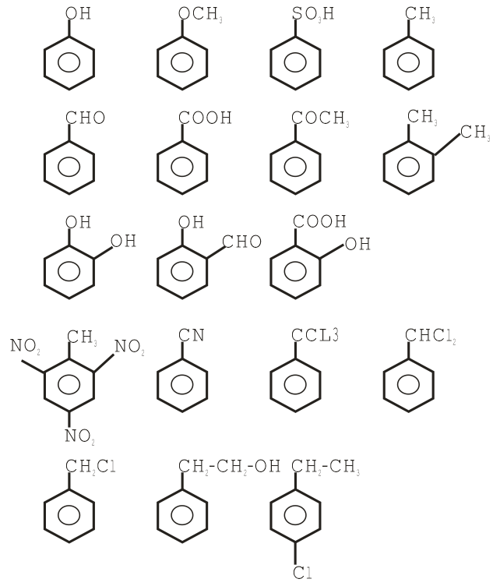
NOMENCLATURE OF BENZENE CONTAINED COMPOUNDS

Slide 45
Priority order of functional group.
COOH > SO₃H > COOR > COCl > CONH₂ > CN > CHO > CO > OH > NH₂ > C = C > C ≡ C

Slide 46
14. The IUPAC name of the following compound is
CH₃-CH-CH₂CH₂CH₃
|
CH(CH₃)₂
1. 2-isopropylpentane 2. 2, 3-dimethylhexane
3. Isononane 4. 2, 4-dimethylhexane

Slide 47
15. Which is correct IUPAC name of the following compound
CH₃ CH₃
| |
CH₃ – CH – CH – CH – CH₃
|
CH₂ – CH₃
1. 3-isopropyl-2-methylpentane
2. 3-ethyl-2, 4-dimethylpentane
3. 2, 4-dimethyl-3-ethylpentane 4. 3-isopropyl-4-methylpentane
16. The correct IUPAC name of
H₂C = CH – CH – CH₂C = CH
|
CH₃
1. 3-methyl-l-hexen-5-yne 2. 3-methyl-5-hexen-l-yne
3. 4-(ethenyl)-l-pentyne 4. 3-(2-propenyl) butene-1

Slide 48

17. What will be the IUPAC name of the given compound
CH₃ CH₃
| |
CH₃ – CH – CH – CH₂ – CH – CH₃
|
CH₂ – CH₃
1. 2, 5 – diethyl – 4 – methylexane
2. 3, 4, 6 – trimethyloctane
3. 2, 5, 6 – trimethyloctane
4. 3, 5 – dimethyl – 6 – ehtylheptane
18. The IUPAC name of the structure is
1. 2, 4, 5 – Triethyl-3-nonene 2. 5,6-Diethyl-2-methyl-4-decene
3. 2, 4, 5 – Triethy-3-octene 4. 3-Ethyl-5-methyl-3-heptane

Slide 49
19. CH₃ – CH = CH – C CH has IUPAC name
1. Pent – 2- ene – 4 – yne 2. Pent – 4 – yne – 2 – ene
3. Pent – 3 – en – 1 – yne 4. Pent – 3- ene – 1 – yne
20. IUPAC name of acetyl salicylic acid is
1. m-benzoic acid 2. 2-acetoxy benzoic acid
3. p-benzoic acid 4. p-acetyl benzoic acid
21. IUPAC name of the compound is
CH₃ – CH – CH₂ – CH(OH) – CH₃ is
|
CH₂
|
CH₃
1. 4-ethyl-2-pentanol 2. 4-methyl-2-hexanol
3. 2-ethyl-2-pentanol 4. 3-methyl-2-hexanol

Slide 50
22. The IUPAC name of CH₃ COOC₂ H₅ will be
1. Ethyl acetate 2. Ethyl ethanoate
3. Methyl propanoate 4. None of these
23. IUPAC name of CH₃ – CH₂ – CH – NH₂ is
|
CH₃
1. 1-methyl-1-aminopropane 2. 2-butanamine
3. 2-methyl-3-aminopropane 4. None of the above
24. What is the correct IUPAC name for
H O
| ||
CH₃ – C – CH = CH – CH₂ – C - OH
|
CH₃
1. 5-methyl-3-hexenoic acid 2. 5-carboxyl-2-methylpentene
3. 4-isopropyl-3-butanoic acid 4. None of above

Slide 51
25. Which is the correct structure of the compound 3-hexyn-l-oic acid?
1. CH₃ – CH₂ – CH₂ – C C – COOH
2. CH₃ – CH₂ – C C – CH₂ – COOH
3. CH₃ – C C – CH₂ – CH₂ – COOH
4. CH₃ – CH₂ – CH = CH – CH₂ – COOH
OH OH
| |
26. The IUPAC name of CH₃ – C – CH₂ – CH – CH₃ is
|
CH₃
1. 4-methyl-1-2, 4, pentanediol
2. 1, 1-dimethyl 1, 1, 3 butanediol
3. 2-methyl-2, 4 pentanediol
4. 1, 2, 3- trimethyl – 1, 3 propanediol

Slide 52
27. The IUPAC name of
CH₃
| CH₂ – CH – CH₂
CH₃ – CH – CH₂ – C – CH₃ and | | |
| | CN CN CN
OH OH
1. 1, 1 – dimethyl-1, 3-butanediol and propanetricarbyl amine
2. 4-methyl-2, 4-pentanediol and 1, 2, 3 propanetrinitrile
3. 2-methyl 2, 4-pentanediol and 1, 2, 3 – propanetricarbonitrite
4. 1, 3, 3-trimethyl 1, 3-propanediol and 1, 2, 3 tricyano propane

Slide 53

28. The IUPAC name for the compound is
1. 2-Acetyl prop-l-ene 2. Pent-1-en-4-one
3. Pent-4-en-2-one 4. Formyl propene
29. The IUPAC name of CH₃ – CH – CH₂ – CH – CHO will be
| |
OH CH₃
1. 4-hydroxy-1-methylpentanal
2. 4-hydroxy-2-methylpentanal
3. 3-hydroxy-2-methylpentanal
4. 3-hydroxy-3-methylpentanal

Slide 54



30. Which of the following has wrong IUPAC name
1. 5-Ethy-1-methylecyclohexene
2. 5-Bromo-6-chloro-1-cyclohexen-3-yne
3. 1, 2-Dimethylcyclopropane
4. 2-methylcyclopent – 4-en-1-ol

Slide 55


31. The IUPAC name of is
1. 1, 1-diethyl-2, 2-dimethylpentane
2. 4, 4-dimethyl-5, 5-diethylpentane
3. 5, 5-diethyl-4, 4-dimethylpentane
4. 3-ethyl-4, 4-dimethylheptane
32. Give IUPAC name of the following structure
1. 3-Chlorocarbonyl ethylbenzene carboxylate
2. 4-chloro-5-(1-propenyl)2, 4-hexa-di-enoic acid
3. 3-chloro 2, 3-di(1-propenyl) propanoic acid
4. 4-carboxy 5-chloro octa-2, 4, 6-tri-ene

Slide 56

33. IUPAC name of the compound
1. 2-Chlorocarbonyl ethylbenzenecarboxylate
2. 2-Carboxyethylbenzoyl chloride
3. Ethyl 2-(chlorocarbonyl) benzenecarboxylate
4. Ethyl 1-(chlorocarbonyl) benzenecarboxylate

Slide 57
ISOMERISM
When two or more compounds possessing the same molecular formula but different properties are known as isomerism.
ISOMERISM
Structural Isomerism Stereoisomerism
Chain Position Functional Metamerism Conformation Geometrical Optical

Slide 58
STRUCTURAL ISOMERISM
Compounds having the same molecular formula but different structures. a. CHAIN ISOMERISM
* Same M.F.
* Different carbon skeleton
E.g.
* CH₃-CH₂-CH₂-CH₂-CH₃ (n-pentane)
* CH₃-CH-CH₂-CH₃ (isopentane)
|
CH₃
CH₃
|
* CH₃-C-CH₃ (neopentane)
|
CH₃

Slide 59
b. Position Isomerism
When an isomerism arises due to change in position of functional group.
E.g. – C₃H₈O
* CH₃ - CH₂ - CH₂ - OH
* CH₃ – CH - CH₃
|
OH c. Functional Group Isomerism
When an isomerism arises due to change in functional group.
E.g. – C₃H₈O C₄H₈O
CH₃-CH₂-CH₂-OH CH₃-CH₂-CH₂-CHO
CH₃-O-CH₂-CH₃ CH₃-CO-CH₂-CH₃

Slide 60
d. Metamerism
It arises due to different alkyl chains on either side of the functional group present in the molecule.
Eg. CH₃ – CH₂ – CH₂ – O – CH₃
CH₃ – CH₂ – O – CH₂ – CH₃

Slide 61
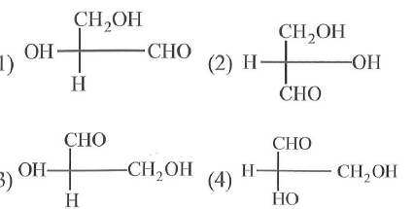
34. The number of possible structural isomers for a compound with the molecular formula C₇H₁₆ is
1. 8 2. 9 3. 10 4. 12
35. Which of the following fischer projection formula is same as D- Glyceraldehyde

Slide 62
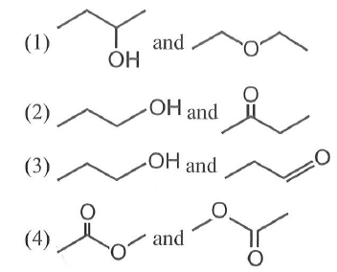
36. Which of the following pairs of compounds are functional isomers?

Slide 63
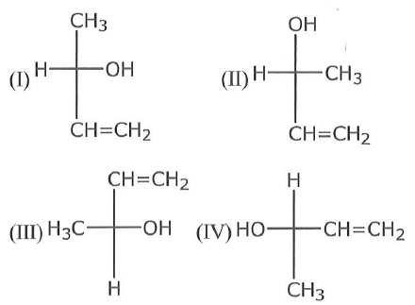
37. Which of the following combinations amongst the four fischer projections represents the same absolute configurations?
1. II and III 2. I and IV 3. II and IV 4. III and IV

Slide 64
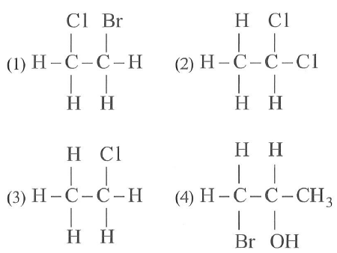
38. Which of the following have asymmetric carbon atom?

Slide 65
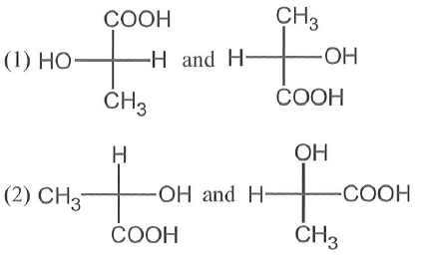
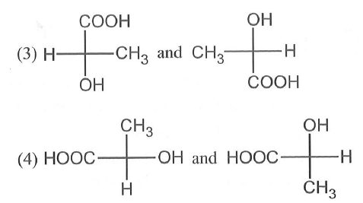
39. Which of the following pairs of structures represent enantiomers?

Slide 66
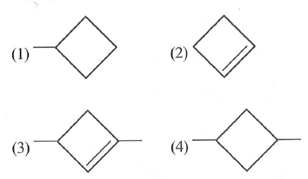
40. Which of the following will show geometrical isomerism?
41. Enol content is highest in
1. Acetone 2. Acetophenone
3. Acetic acid 4. Acetyl acetone

Slide 67
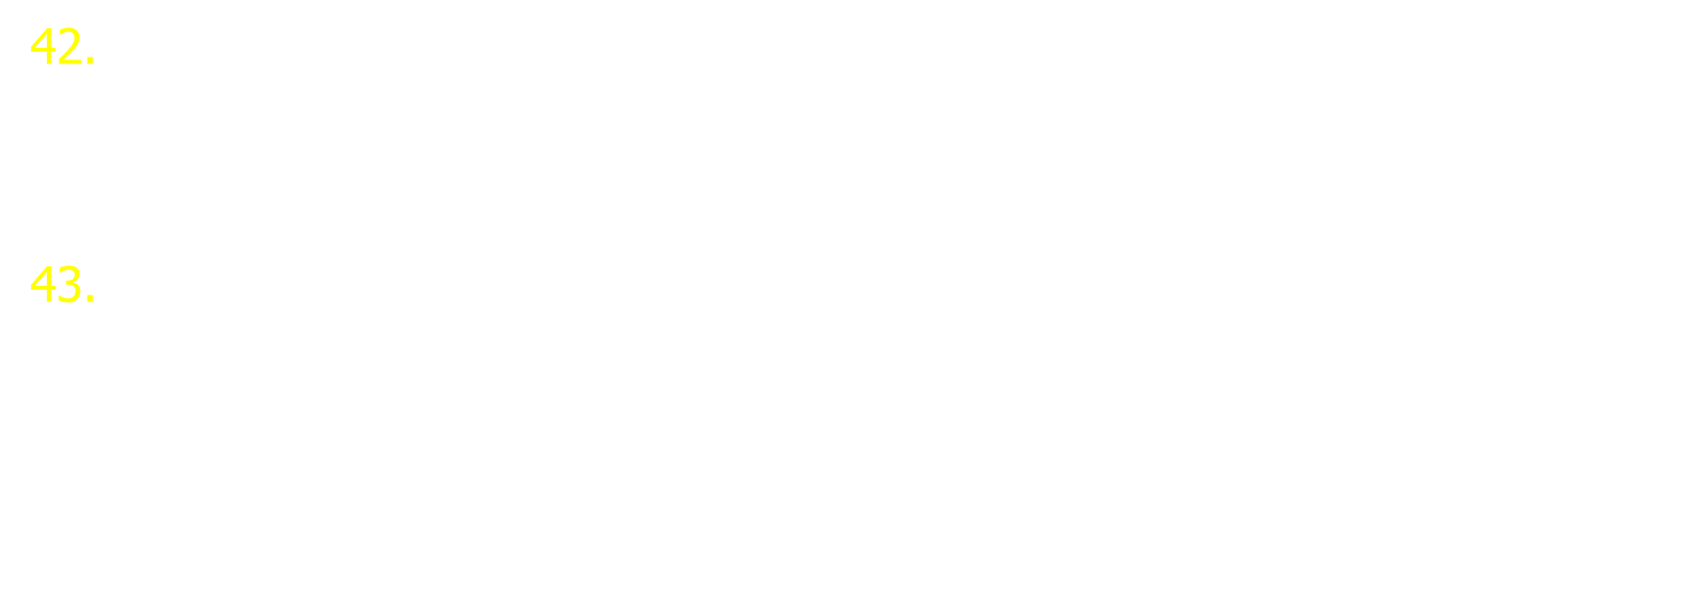
42. Hydrogen bonding is maximum in
1. C₂ H₅ OH 2. CH₃ –O-CH₃ 3. (CH₃)₂ C= O 4. CH₃ CHO
43. The enolic form of acetone contains
1. 8$σ$-bonds, 2$π$-bonds and 1 lone pairs
2. 9$σ$-bonds, 1$π$-bonds and 2 lone pairs
3. 9$σ$-bonds, 2$π$-bonds and 1 lone pairs
4. 10$σ$-bonds, 1$π$-bonds and 1 lone pairs

Slide 68
FUNDAMENTAL CONCEPTS IN ORGANIC REACTION MECHANISM
* SUBSTRATE
* INTERMEDIATE
* PRODUCT

Slide 69
TYPES OF BOND FISSION
1. Heterolytic Cleavage
* In heterolytic cleavage, the bond breaks in such a fusion that the shared pair of electrons remains with one of the fragments.
A B → A⊕ + B^{Θ}
[EN of A < EN of B]

Slide 70

2. Homolytic cleavage
One of the electron of the shared pair in a covalent bond goes with each of bonded atom resulting in the formation of free radicals.
A B →

Slide 71
Reaction Intermediate
1. Carbocation
2. Carbanion

Slide 72
3. Free Radical
4. Carbene

Slide 73
ELECTRON DISPLACEMENT EFFECTS IN COVALENT BONDS
1. INDUCTIVE EFFECT

Slide 74
2. Resonance Effect
* In some cases, a number of structures are needed to explain all the properties a compound
* These structures are called as Resonance Structures
* The actual structure is call resonance hybrid.
Eg. O₃

Slide 75
3. Hyper Conjugation Effect

Slide 76
4. Electromeric Effect

Slide 77
44. The order of decreasing stability of the carbanions
1. I > II>III>IV 2. IV>III>II>I
3. IV>I>II>III 4. I>II>IV>III
45. Which of the following show +1-effect:
1. -OH 2. -OCH₃ 3. -CH₃ 4. -CI
46. Orbital interaction between the sigma bonds of a substituent group and a neighbouring p-orbital is known as
1. Hyperconjugation 2. Inductive effect
3. Steric effect 4. Dipole-dipole interactions

Slide 78
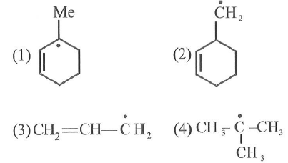
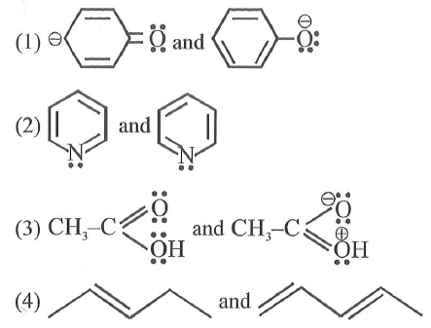
47. Which one is most stable free radical:
48. Which of the following is not a pair of resonance structures :

Slide 79
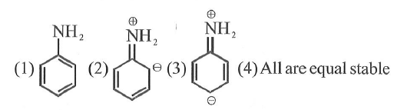
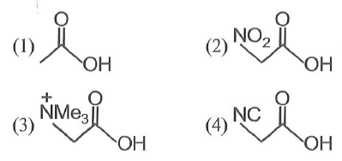
49. The most stable resonating structure of aniline is
50. Which of he following has the highest pK_{a} value?

Slide 80
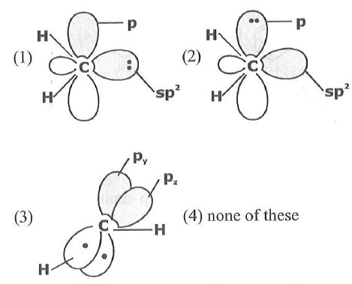
51. The orbital picture of a singlet carbene (:CH₂) can be drawn as

Slide 81
NUCLEOPHILES
* Nucleus loving species
* -vely charged or neutral
* Lewis base
Eg. Cl⁻, OH⁻, H⁻, H₂O, NH₃
ELECTROPHILES
* electron loving species
* +vely charged or neutral
* Lewis acid
Eg. HΘ⊕, R⊕, NO₂⊕, PCl₃, PCl₅.
NH⊕₄ and H⊕₃O are not electrophile

Slide 82
52. Which of the following is an electrophile
1. H₂O 2. SO₃ 3. NH₃ 4. ROR
53. Strongest nucleophile is
1. RNH₂ 2. ROH 3. C₆H₅O⁻ 4. CH₃ O⁻

Slide 83
TYPE OF ORGANIC REACTIONS AND MECHANISMS
1. Substitution Reaction
2. Addition Reaction

Slide 84
3. Elimination Reaction
4. Rearrangement Reaction

Slide 85
METHODS OF PURIFICATION OF ORGANIC COMPOUNDS
Organic compounds obtained either from natural sources or synthetic processes in the laboratories are contaminated with impurities. These are purified by different methods.
1. Methods of purification of solids a. Crystallisation
* This method is useful to purify the solid organic compounds
* The principle involved in this method is that the compound should be insoluble at low temperature but soluble at higher temperatures in the given solvent. Impurities are either insoluble or soluble and go into filtrate

Slide 86
* The insoluble impurities are removed by filtration in hot condition.
* The crystals of the compound are separated by filtering under reduced pressure using Buckner funnel
* Repeated crystallization is required and the coloured impurities are removed by adsorbing them with activated charcoal
Fractional crystallization
E.g. Alcohol & Water, Chloroform & Petroleum ether
2. Sublimation
* It is used to purify activated solid organic compounds which undergoes sublimation.
* If the compounds is sublimating the impurity should not sublimate.

Slide 87
* If the compound to be purified has highly vapour pressure below its melting point and sublimates readily on heating and the impurities don’t sublimate.
* The pure compound is separated by scratching the watch glass
* If the sublimating substances have a low vapour pressure or decompose on heating before sublimation, then the sublimation is carried out under low pressure
* Camphor, Naphthalene, Anthracene, Benzoic acid, Phtalic anhydride Anthraquinone are purified by sublimation

Slide 88
II. Methods of purification of liquids
1. Simple distillation
* The vapourisation of a liquid by, heating and subsequent condensation of vapours by cooling is known as distillation
* This process is useful for purification of liquids contaminated with non volatile impurities
* The liquids that have boiling point difference greater than 40ºC can be purified by this method.
* Aniline (b.p. 457 K) & Chloroform (b.p. 334 K) are easily separated by distillation

Slide 89
2. Fractional distillation
* This process is useful for the purification of liquids having boiling point difference less than 40ºC.
* In this process, liquid with high b.p. is collected in the condenser and liquid with low b.p. is collected in thee receiver
* Fractionating column provides many surfaces for heat exchange between the ascending vapours and the descending condensing liquid
* Each successive condensation and vapourisation unit in the fractionating column is called theoretical plate.
* Commercially, columns with hundreds of plates are available.
E.g. Acetone & Methanol

Slide 90
3. Distillation under reduced pressure
* This method is useful to purify liquids that have very high boiling points and those which decompose at or below their boiling points.
* At reduced pressure the boiling point of a liquid is also reduced. Hence its decomposition is prevented.
* H₂O₂, Glycerol, formaldehyde are purified by this method Purification (1).

Slide 91
4. Steam distillation
* The liquids insoluble in water possess high boiling point and steam volatile and the impurities are not steam volatile are purified by this method.
* Principle in steam distillation is – sum of the vapour pressure of organic liquid (P₁) and that of water (P₂) is equal to atmospheric pressure (P) and mixture boils.
* The water layer and the organic liquid layer are separated using separating funnel.
Ex. Aniline is purified by this method from Aniline – water mixture
Relative masses obtained is steam distillation process is calculated by a formula
=

Slide 92
Where W_{A} and W_{B} are the masses of A and B M_{A} and M_{B} are the molecular masses of A and B.
Pº_{A} and Pº_{B} are the vapour pressures of A and B.
* At 98.5º C water and aniline have vapour pressures 717 torr and 43 torr. In steam distillation at 98.5ºC, the relative masses obtained are
W_{H2O} 717 x 18
--------- = ------------ = 3.23
W_{Aniline} 43 x 9

Slide 93
5. Solvent extraction (different extraction)
* In this method, organic compound is separated from its aqueous solution by using its solubility which is different with organic solvent and water.
6. Chromatography
* It was discovered by Tswett in (1906). He separated chlorophyll and Xanthophyll and other compounds by using absorbent CaCO₃.
* It is classified into three types based on the physical states of stationary phase and mobile phase
* Chromatography involves three steps a. Absorption and retention of a mixture of substances on the stationary phase and separation of adsorbed substances by the mobile phase to different distance on the stationary phase

Slide 94
b. Recovery of the substance separated by a continuous flow of the mobile phase (known as elution) c. Qualitative and quantitative analysis of the eluted substances important chromatography techniques are
1. Adsorption chromatography i. Column chromatography ii. Thin layer chromatography
2. Partition chromatography i. Paper chromatography

Slide 95
i. Column chromatography
* The principle used in this method is differential adsorption
* In the column chromatography the components of a mixture are separated by a column of adsorbent (stationary phase) packed in a glass tube.
* The mixture to be adsorbed on the adsorbent is placed at the top of the stationary phase.
* A suitable eluant, either a single solvent or a mixture of solvents is allowed to flow down the column slowly
* The most readily adsorbed substances are retained near the top and others come down accordingly to various distances.

Slide 96
ii. Thin layer chromatography (TLC)
* This also based on the adsorption differences.
* The glass plate which is coated with adsorbent
(E.g. : Silica get, alumina) as a thin layer (0.2 mm thick) is called TLC plate or chromoplate.
* The plate is then kept in a closed jar containing the eluant.
* The relative adsorption of a component of the mixture is expressed in terms of Retardation Factor (R_{f}) value
Distance moved by the substance from base line (X)
R_{f} = ----------------------------------------------------------------
Distance moved by the solvent from base line (Y)

Slide 97
* The colourless compounds which fluorescence are detected with ultraviolet light.
* Spots of compounds are even detected by allowing them to adsorb iodine, when they give brown spots.
* Some times an appropriate reagent is sprayed, as ninhydrin solution to detect aminoacids.

Slide 98
C. Partition Chromatography
* This is based on continuous differential partitioning of components of a mixture between the stationary phase and the mobile phase.
Sl. No | Chromotography Process | Stationary Phase | Mobile Phase
1 | Column Chromotograph (Adsorption) | Solid | Liquid
2 | Liquid – liquid portion Chromatography | Liquid | Liquid
3 | Paper Chromatography | Liquid | Liquid
4 | Thin Layer Chromatography (TLC) | Liquid (or) solid | Liquid
5 | Gas-Liquid Chromatography (GLC) | Liquid | Gas
6 | Gas-Solid Chromatography (GSC) | Solid | Gas
7 | Ionic Change Chromatography | Solid | Liquid

Slide 99
* In paper chromatography, a special paper called chromatography paper contains water trapped in it which acts as the stationary phase
* The chromatography paper spotted with the solution of the mixture at the base is suspended in a suitable solvent or a mixture of solvents. This solvent (s) acts as the mobile phase
* The solvent rises up the paper by capillary action and moves over the spot
* The paper selectively retains different components as per their differing partition in mobile and stationary phases and is known as chromatogram.
* The spots of the separated coloured compounds are detected

Slide 100
QUALITATIVE ANALYSIS OF ORGANIC COMPOUNDS
1. Detection of carbon and hydrogen
* Carbon and hydrogen are detected with –CuO (Cupric Oxide)
* If carbon is present, its forms CO₂ gas. The CO₂ gas turns lime water milky
C + 2CuO → 2Cu + CO_{2↑}
Ca(OH)₂ + CO₂ → CaCO₃↓
* If hydrogen is present in the compound it forms H₂O vapour.
H₂O vapours when passed over white anhydrous CuSO₄ turns it blue by forming CuSO₄.5H₂O.
2H + CuO → Cu + H₂O
CuSO₄ + 5H₂O → CuSO₄.5H₂O
(white) (blue)

Slide 101
2. Detection of halogen, nitrogen and sulphur
(Lassaigne’s test or sodium extract test)
* In Lassaigne’s test, the compound is heated strongly in an ignition tube to fuse with sodium metal. Here nitrogen present in the organic compound is converted as CN⁻.
Na + C + N → NaCN from organic compound sodium cyanide
* If sulphur is present in the organic compound is converted as S²⁻.
2Na + S → Na₂S
Sodium sulphide
* If halogens are present in the organic compound are converted as X⁻.
2Na + X₂ → 2NaX (X = Cl, Br, I)

Slide 102
* The above obtained fused mass is extracted with water by plugging the red hot ignition tube in distilled water and the contents are boiled for 10 minutes and filtered. The filtrate is called sodium extract. i. Test for nitrogen
* Take a portion of the sodium extract, if it is not alkaline add NaOH solution to it and then freshly prepared ferrous sulphate solution.
* Now add 2 or 3 drops of FeCl₃ solution, cool, acidify with conc. HCl.
* A Prussian blue or green precipitate (or) coloration is observed if nitrogen is present.
FeSO₄ + 2NaOH → Fe(OH)₂ + Na₂SO₄
6NaCN + Fe(OH)₂ → Na₄[Fe(CN)₆] + 2NaOH sodium ferrocyanide
3Na4[Fe(CN)₆] + 4FeCl₃ → Fe₄[Fe(CN)₆]₃ + 12 NaCl
Ferric ferrocyanide (Prussian blue)

Slide 103
Detection of Nitrogen
* Sodalime test : A pinch of an organic compound is heated strongly with sodalime (NaOH+CaO) in a test tube the evolution of ammonia gives the indication of Nitrogen
* Limitation : A large number of organic compounds such as nitro and diazo compounds do not liberate ammonia under these conditions. ii. Test for sulphur
* To a portion of the Na extract add freshly prepared sodium nitroprusside solution
* A deep violet colouration takes place
S²⁻ + [Fe(CN)₅ NO]²⁻ → [Fe(CN)₅ NOS]⁴⁻ nitroprusside violet
* If N, S both are present gives thiocynate,
Na + C + N + S → NaSCN

Slide 104
* To this, FeCl₃ solution is added,
Fe³⁺ + SCN⁻ → [Fe(SCN)₆]⁻³
* It gives only blood red colour
* No Blood red colour or Prussian blue colour indicates that there are no N or S. If sodium fusion is carried out with excess of `Na’ the thiocyanate decomposes to yield CN⁻ and S²⁻
NaSCN + 2Na → NaCN + Na₂S
* Sodium fusion extract is acidified with acetic acid and then lead acetate solution is added
Pb²⁻ + S²⁻ → PBS black ppt

Slide 105
iii. Tests for Halogens
The sodium fusion extract is acidified with nitric acid. Now it is treated with AgNO₃ solution.
Ag⁺ + X⁻ → AgX
* If white precipitate is formed that is soluble in NH₄OH solution, the halide is Cl⁻. Hence chlorine is present.
* If pale yellow precipitate, sparingly soluble in NH₄OH solution is formed it is (I⁻) iodide and the halogen is iodide
Function of HNO₃
In case N and S are present along with halogens in the organic compound, the Lassaigne’s extract contains Na₂S and NaCN along with NaX. HNO₃ decomposes NaCN and Na₂S which otherwise form ppt with AgNO₃ and thus, interfere with the test.

Slide 106
Beilstein’s test
A copper wire flattened at one end is heated in the oxidizing flame of Bunsen burner. The heating is continued till it does not impart blue colour flame. The hot end of copper wire is now touched with the organic substance and is once again kept in flame. The reappearance of green or blue colour indicates the presence of Halogens in the Organic compound.
Limitations a. Substance such as Urea, thiourea do not contain halogens but given this test. b. It does not tell as to which halogen is present in the organic compound

Slide 107
c. Detection of phosphorus
* The compound is heated with an oxidizing agent say sodium peroxide. The `P’ in the organic compound is oxidized to PO₄³⁻. The solution is boiled with HNO₃ and treated with ammonium molybdate.
* A canary yellow precipitate formation indicates the presence of phosphorous in the compound.
Na₃PO₄ + 3HNO₃ → H₃PO₄ + 3NaNO₃
H₃PO₄+12(NH₄)₂ MoO₄+21HNO₃ → (NH₄)₃ PO₄ . 12MoO₃ + 12H₂O
Ammonium phosphomolybdate

Slide 108
d. Detection of Oxygen
* There is no direct test for oxygen
* The organic compound when heated in pure nitrogen atmosphere if water droplets are formed on the walls of the test tube oxygen is detected.
* Otherwise after determining the % composition of all elements in the compounds if it does not come to 100%, the remaining is of oxygen
* Even by detecting functional groups like –OH, CHO, COOH, NO etc., oxygen is detected.

Slide 109


QUANTITATIVE ORGANIC ANALYSIS
1. Estimation of Carbon and Hydrogen (Leibig method)
* A known weight of the organic substance is taken and completely burnt in excess of air & Copper (II) oxide. Carbon changes to CO₂ and hydrogen changes to H₂O as follows.
* The CO₂ and H₂O obtained are passed through weighed
U tubes containing anhydrous CaCl₂ and caustic potash respectively. The increased weight of these two tubes give the weight of H₂O formed and weight of CO₂ formed.

Slide 110
12 Wt. of CO₂ formed
% of C = ------ x ----------------------------------- x 100
44 Wt. of Organic compound
2 Wt. of H₂O formed
% of H = ------ x ----------------------------------- x 100
18 Wt. of Organic compound
* After calculating the percentage composition all C and H in the compound if their sum is not 100, then the difference is assumed as oxygen.

Slide 111

2. Estimation of Nitrogen
* There are two methods of estimate nitrogen in the given compound. They are i. Duma’s method ii. Kjeldahl’s method i. Duma’s method
* In this method a known weight of organic compound is heated strongly with dry cupric oxide. Carbon and hydrogen get oxidized to carbon-di-oxide and water vapour. Nitrogen if present is converted to N₂ is collected over KOH solution and its volume is determined at S.T.P.
28 Volume of Nitrogen at S.T.P.
% of N = -------- x ---------------------------------- x 100
22400 Weight of organic compound

Slide 112
ii. Kjeldahl’s method
* In this method the given organic compound is treated with conc. H₂SO₄ in the presence of small amounts of CuSO₄ to convert nitrogen into ammonium sulphate. Then ammonium sulphate is treated with excess of NaOH to liberate NH₃ gas.
* The ammonia evolved is neutralized with excess of conc. H₂SO₄ which is relatively more in amount than that is required to neutralize NH₃ formed is calculated and from that percentage of nitrogen is calculated.
Organic compounds + H₂SO₄ → (NH₄)₂ SO₄
(NH₄)₂ SO₄ + 2NaOH → Na₂SO₄ + 2H₂O + 2NH₃
2NH3 + H₂SO₄ → (NH₄)₂SO₄

Slide 113
1.4 x N x V
* % of N = -----------------------------------
Wt. of organic compound
* Where N = Normality of acid
V = Volume of acid (ml) neutralized by ammonia
* Kjeldahl’s Method : This method is, however, not applicable to compounds containing nitrogen in the ring, like pyridine and the compounds containing NO₂ and diazo (-N = N-) groups.
3. Estimation of halogens (Carius method)
* In this method a known weight of organic compound is heated with fuming nitric acid in the presence of AgNO₃ in a hard glass tube called Carius tube.

Slide 114
* Carbon and hydrogen of the compound are oxidized to CO₂ and H₂O. Halogen forms Silver halide (AgX). It is filtered, washed dried & weighed.
At wt. of X
* % of Halogen (X) = ----------------------------
Mol. Wt. of AgX
Wt. of AgX
---------------------------------- x 100
Wt. of Organic Compound
35.5 Wt. of AgCl formed
* % of Cl = ---------- x ----------------------------------- x 100
143.5 Wt. of Organic compound

Slide 115
80 Wt. of AgBr formed
* % of Br = ---------- x ----------------------------------- x 100
188 Wt. of Organic compound
127 Wt. of AgI formed
* % of I = ---------- x ----------------------------------- x 100
235 Wt. of Organic compound
* Note : Carius method does not given satisfactory results in case of estimation of iodine because Agl is slightly soluble in HNO₃.

Slide 116
4. Estimation of Sulphur
* A known weight of organic compound containing sulphur is heated with Na₂O₂ or fuming HNO₃ in a Carius tube. The sulphur in it is oxidized to H₂SO₄. The acid is precipitated as BaSO₄ by adding excess of BaCl₂ solution. The precipitate is filtered, washed dried and weighed.
32 Wt. of BaSO₄
* % of S = ---------- x ----------------------------------- x 100
233 Wt. of Organic compound

Slide 117
5. Estimation of Phosphorus
* To estimate phosphorus in the given organic compound, a known mass of organic compound is heated with fuming nitric acid in a Carius tube. Phosphorus is oxidized to phosphoric acid. The acid is precipitated as ammonium phosphomolybdate (NH₄)₃PO₄.12MnO₃ by adding ammonia and ammonium molybdate solutions.
* Sometimes, the acid is precipitated by adding magnesia mixture
* Magnesia mixture is obtained by dissolving 100.0g of MgCl₂.6H₂O and 100.0g of NH₄Cl in water, then adding 50.0 ml of conc. NH4OH and diluting the solution to
1000 ml.

Slide 118
* A precipitate of Magnesium ammonium phosphate
(Mg NH₄PO₄) is formed which on ignition gives magnesium pyrophosphate (Mg₂P₂O₇).
2 x 3.1 Wt. of Mg₂P₂O₇
* % of P = ---------- x ----------------------------------- x 100
222 Wt. of Organic compound
(or)
31 Wt. of (NH₄)₃PO₄. 12MoO₃
* % of P = -------- x --------------------------------------- x 100
1877 Wt. of Organic compound

Slide 119
6. Estimation of Oxygen
* The percentage of oxygen in an organic compound is found indirectly by the difference between 100 and total percentage of other elements.
* In the direct method, a known mass of organic compound is decomposed by heating in a stream of nitrogen gas. The mixture of gaseous product containing oxygen is passed over red hot coke to convert all oxygen in those oxides to CO. Then the mixture is passed through warm iodine pentoxide (I₂O₅) to convert CO to CO₂ and liberating iodine.
Heat
* Compound O₂ + other gaseous products
N₂
1373 k
2C + O₂ 2CO;
I₂O₅ + 5CO → I₂ + 5CO₂

Slide 120
Thank you

